Slide 1
Lecture #9: Simple Indexing
CME2002 Data Organization and Management
Dr.Adil Alpkocak

Slide 2
Cost of Reading
Cost of Reading = s + r + btt
seek time (s) : the time required to move the access arm to the correct cylinder
Rotational Delay (r) : average time it takes to locate the correct block on a track once the head is on the correct track
Block transfer time (btt): the time it takes to transfer the information in one block on the disk to memory

Slide 3
Indexing: Finding Things Quickly
The cost of seeking is very high.
This cost has to be taken into consideration when determining a strategy for searching a file for a particular piece of information.
The same question also arises with respect to sorting, which often is the first step to searching efficiently.
Rather than simply trying to sort and search, we concentrate on minimizing the number of seeks.

Slide 4
Binary Search and Internal Sorting
Sequential search
At most n comparisons -> O(n)
e.g., at most 100,000 comparisons for 100,000 items
Too expensive -> we need to find a better way to handle keyed access
Binary search
At most [log ₂n] + 1 comparisons -> O(log n)
e.g., at most 17 comparisons for 100,000 items
However, a data file is kept sorted on the key
Internal sort
Reading and sorting a disk file in RAM
A good illustration of an internal sort is the UNIX sort utility, which sorts files in RAM if it can find enough space.

Slide 5
Limitations of Internal Sorting and Binary Search
Binary searching requires still expensive disk access cost
If there are 100,000 items, binary search requires at most 17 accesses. Although this is a tremendous improvement over a sequential search, it is also true that 17 accesses is not negligible cost.
Keeping a file sorted is very expensive
Inserting a new record into the file requires, on the average, that we not only read through half the records, but that we also shift the records to open up the space required for the insertion.
An internal sort works only on small files
An internal sort works only if we can read the entire contents of a file into the computer’s electronic memory.

Slide 6
Keysorting: Example
KEYNODES array
Records
KEY
RRN
...................
HARRISON SUSAN
Harrison|Susan|387 Eastern...
1
KELLOG BILL
Kellog|Bill|17 Maple...
2
HARRIS MARGARET
Harris|Margaret|4343 West...
3
...
...
BELL ROBERT
Bell|Robert|8912 Hill...
k
In RAM
On Secondary Storage
KEYSORTING: Conceptual view of KEYNODES array to be used in RAM by internal sort routine, and record array on secondary store

Slide 7
KEYSORTING: Conceptual view of KEYNODES array and file after sorting keys in RAM
Keysorting: Example
KEYNODES array
Records
KEY
RRN
...................
BELL ROBERT
Harrison|Susan|387 Eastern...
k
HARRIS MARGARET
Kellog|Bill|17 Maple...
3
HARRISON SUSAN
Harris|Margaret|4343 West...
1
...
...
KELLOG BILL
Bell|Robert|8912 Hill...
2
In RAM
On Secondary Storage

Slide 8
Keysorting: Another Solution
Instead of creating a new, sorted copy of the file to use for searching, we maintain an index file that is to be used in conjunction with the original file
Index file
Original file
BELL ROBERT
Harrison|Susan|387 Eastern...
k
HARRIS MARGARET
Kellog|Bill|17 Maple...
3
HARRISON SUSAN
Harris|Margaret|4343 West...
1
...
...
KELLOG BILL
Bell|Robert|8912 Hill...
2

Slide 9
Limitations of the Keysort Method
We need to read in the records once again before writing them out to the new file
Doing something twice is never desirable!!!
The disk drive must move the head back and forth between the two files as it reads and writes
The cost of seeking is too expensive!!!

Slide 10
KeySorting
Overview: when sorting a file in memory, the only thing that really needs sorting are record keys.
Keysort algorithms work like internal sort, but with two important differences:
Rather than read an entire record into a memory array, we simply read each record into a temporary buffer, extract the key and then discard.
If we want to write the records in sorted order, we have to read them a second time.

Slide 11
Simple Indexing

Slide 12
What is an Index?
First, we examine simple indexes which use simple arrays of a pair (key, reference fields)
e.g., indexes of may books, library card catalog
How can we index fixed-length record or variable-length record files?
From now on, assume an extensive collection of musical recordings
Primary key: label + ID (e.g., LON2312)

Slide 13
Contents of Sample Recording File
Record
address
Label
ID
number
Title
Composer(s)
Artists(s)
17 LON 2312 Romeo and Juliet Prokofiev Maazel
62 RCA 2626 Quartet in C Beethoven Julliard
Sharp Minor
117 WAR 23699 Touchstone Corea Corea
152 ANG 3795 Symphony No.9 Beethoven Giulini
196 COL 38358 Nebraska Springsteen Springsteen
241 DG 18807 Symphony No.9 Beethoven Karajan
285 MER 75016 Coq d’or Suite Rimsky-Korsakov Leinsdorf
338 COL 31809 Symphony NO.9 Dvorak Bernstein
382 DG 139201 Violin Concerto Beethoven Ferras
427 FF 245 Good News Sweet Honey Sweet Honey
in the Rock in the Rock

Slide 14
Index of the Sample Recording File
Index file
Record File
Key
Reference
field
Address of
record
Actual data record
ANG3795 152
17
LON|2312|Romeo and Juliet|Prokofiev|...
COL31809 338
62
RCA|2626|Quarter in C Sharp Minor|...
COL38358 196
117
WAR|23699|Touchstone|Corea|...
DG139201 382
152
ANG|3795|Symphony No.9|Beethoven|...
DG18807 241
196
COL|38358|Nebraska|Springsteen|...
FF245 427
241
DG|18807|Symphony No.9|Beethoven|...
LON2312 17
285
MER|75016|Coq d’or Suite|Rimsky-Korsakov|...
MER75016 285
338
COL|31809|Symphony No.9|Dvorak|...
RCA2626 62
382
DG|139201|Violin Concerto|Beethoven|...
WAR23699 117
427
FF|245|Good News|Sweet Honey In the Rock|...

Slide 15
Some Features of a Simple Index with a Entry-Sequenced File
The data file is entry sequenced, meaning that the records occur in the order that they are entered into the file
The index file consists of fixed-length records and much smaller than the data file

Slide 16
Indexing to Provide Access by Multiple Keys
Secondary key
Primary key
Secondary key
Primary key
BEETHOVEN ANG3795
COD D’OR SUITE MER75016
BEETHOVEN DG139201
GOOD NEWS FF245
BEETHOVEN DG18807
NEBRASKA COL38358
BEETHOVEN RCA2626
QUARTET IN C SHARP M RCA2626
COREA WAR23699
ROMEO AND JULIET LON2312
DVORAK COL31809
SYMPHONY NO.9 ANG3759
PROKOFIEV LON2312
SYMPHONY NO.9 COL31809
RIMSKY-KORSAKOV MER75016
SYMPHONY NO.9 DG18807
SPRINGSTEEN COL38358
TOUCHSTONE WAR23699
SWEET HONEY IN THE R FF245
VIOLIN CONCERTO DG139201
Note that secondary key references (e.g., Beethoven) are related to a primary key (e.g., DG18807) rather than a byte offset (e.g., 241).

Slide 17
Indexing to Provide Access by Multiple Keys
Secondary indexes affects fundamental file operations:
Record Addition
Adding a record to the data file means adding an entry to the secondary index
records in secondary index must be shifted
Record Deletion
Removing a record from the data file means
Removing the corresponding entry in the primary index
Removing all of the entries in the secondary indexes referring to this primary index entry
Record Updating
When changing the secondary key, we have to reorder the secondary index
When changing the primary key, we update only the affected reference field(e.g., label ID) in all the secondary indexes

Slide 18
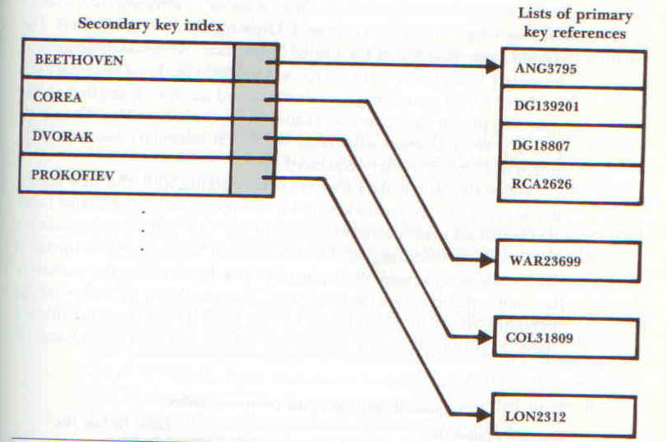

Slide 19
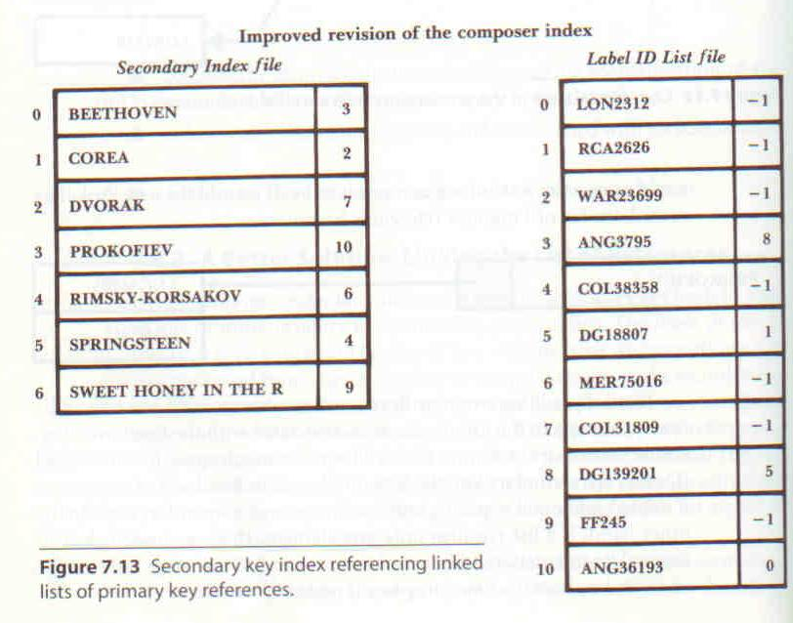

Slide 20
Binary Search versus Sequential Search
Binary Search of a file with n records takes O(log₂n) comparisons.
Sequential search takes O(n) comparisons.
When sequential search is used, doubling the number of records in the file doubles the number of comparisons required for sequential search.
When binary search is used, doubling the number of records in the file only adds one more guess to our worst case.
In order to use binary search, though, the file first has to be sorted. This can be very expensive.

Slide 21
Indexing with Binary Search Trees: Positive Aspects
No longer have to sort the file to perform a binary search.
To add a new key, we simply link it to the appropriate leaf node.
If the tree remains balanced, then the search performance on this tree is good.
Problems occur when the tree gets unbalanced.

Slide 22
Binary Search Trees
You read in an entire page from the file.
When searching a Binary Tree, the number of seeks necessary is log₂(N+1).
It is log_{k+1}(N+1) in the paged binary tree version

Slide 23
Multi-Level Indexing: A Better Approach to Tree Indexes
Up to this point, in this lecture, we’ve looked at indexing a file based on building a search tree.
Instead, we get back to the notion of the simple indexes we saw earlier in the course, but we extend this notion to that of multi-record indexes and then, multi-level indexes.
While multi-record multi-level indexes really help reduce the number of disk accesses and their overhead space costs are minimal, inserting a new key or deleting an old one is very costly.

Slide 24
B-Trees: Addressing the problems of Paged Trees and Multi-Level Indexing
Trees appear to be a good general solution to indexing, but each particular solution we’ve looked at so far presents some problems.
Paged Trees suffer from the fact that they are built downward from the top and that a “bad” root may unbalance the construct.
Multi-Level Indexing takes a different approach that solves many problems but creates costly insertion and deletion.
An ideal solution would be one that combines the advantages of the previous solutions and does not suffer from their disadvantages.
B-Trees appear to do just that!

Slide 25
B-Trees: An Overview
BST top-down approach
B-Trees is a bottom-up approach.
B-Trees are multi-level indexes that solve the problem of linear cost of insertion and deletion.
B-Trees are now the standard way to represent indexes.

Slide 26
B+tree
Non-leaf
Pages
Leaf
Pages
Non-leaf pages have index entries; only used to direct searches
Leaf pages contain data entries, and are chained (prev & next)

Slide 27
Summary
Today
Recaped Sequential Processing
Simple Indexing
Thursday
Tutorial on Binary Search Indexing
Next Week
B-tree

